Slide 1



Kevin Horsley
Award-winning PR, marketing & change communications
expert

Slide 2





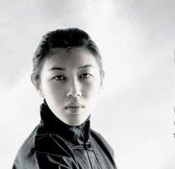

Former journalist and experienced strategic/tactical Corporate Communications Consultant
International awards for PR and marketing communications excellence
Skilled across multi- integrated communications disciplines with experience in a wide variety of industries
Digital and social media savvy. Developed intranet and internet sites for Novartis & Syngenta and others
Devised and Managed major communications programs for Novartis, Roche Clariant and Syngenta
Launched SharePoint, Google Analytics, One Drive for Business & Yammer sites and campaigns for a number of companies

Slide 3
Novartis
Driving global communication programs

Slide 4
Novartis.com - created a new media landing page and remodeled the media library
Worked on Comms plans for the Chairman in China, CEO transitioning; FRESCO; Jedi (Alcon); AveXis; WeWontRest; Created our own web-style Sharepoint site

Slide 5
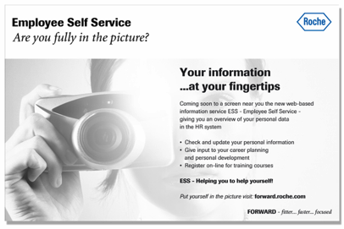
Case study: Project Forward
European business harmonization program for Roche. Highlights:
Created the overall branding - theme representing the spirit of teamwork
Established network of communicators in impacted countries throughout Europe
Created electronic communications toolbox – posters, brochures, training materials etc.
Over the 3 years, overturned negative perceptions and gained support for the programme

Slide 6
mySyngenta intranet content
Worked on the development of the new mySyngenta intranet
Helped devise the user interface
Developed the communications campaign collateral
Delivered off-the-shelf campaign tool-kits in many languages

Slide 7
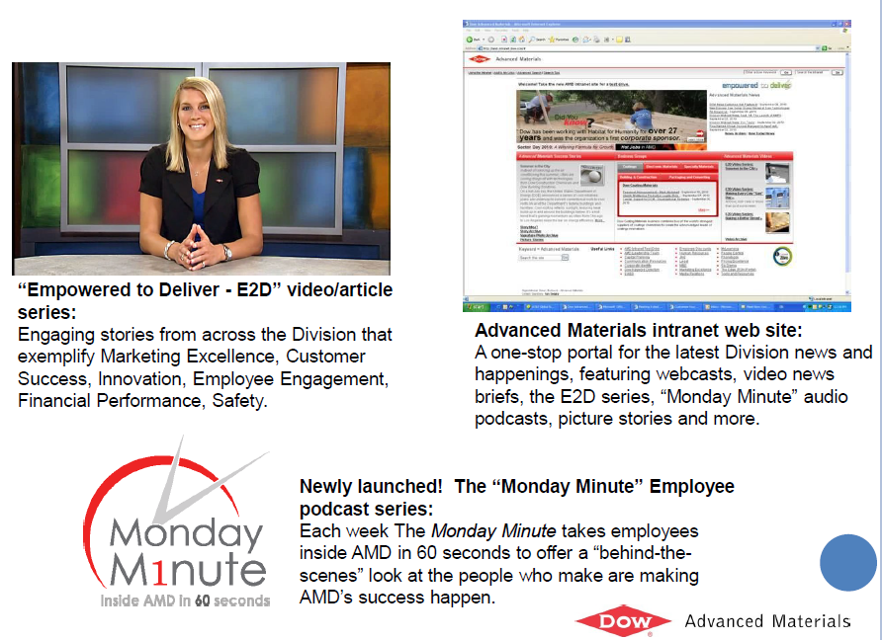
Dow intranet content
Web site, news programmes and podcasts for Dow

Slide 8
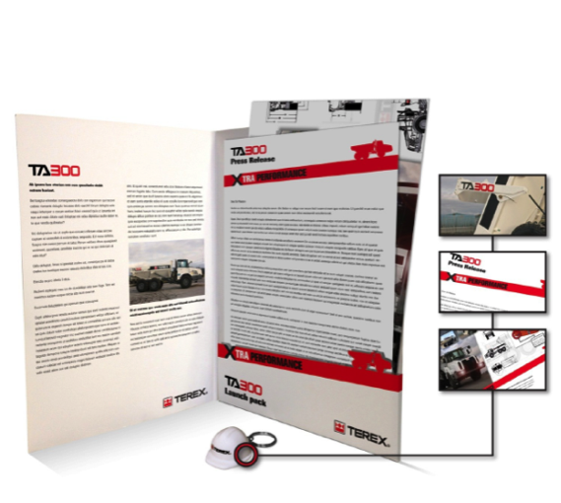
Press pack: TEREX
On line and print versions containing:
Press release
Technical poster, data sheet and support materials
USB key ring. On the USB is all the imagery, fact sheets, video, text and supporting material that the communicator needs for a complete campaign

Slide 9
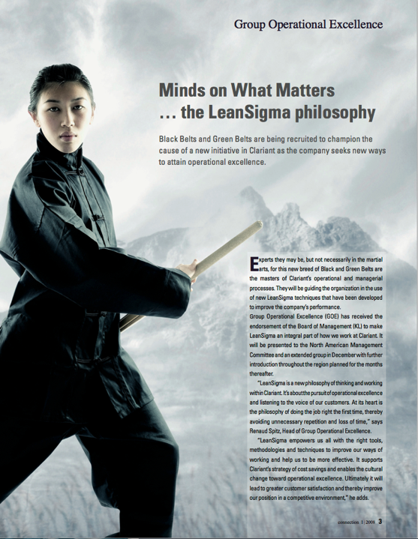
Clariant example of an article I wrote for the in-house magazine…part of a wider change communication campaign raising awareness of the Group Operational Excellence program

Slide 10
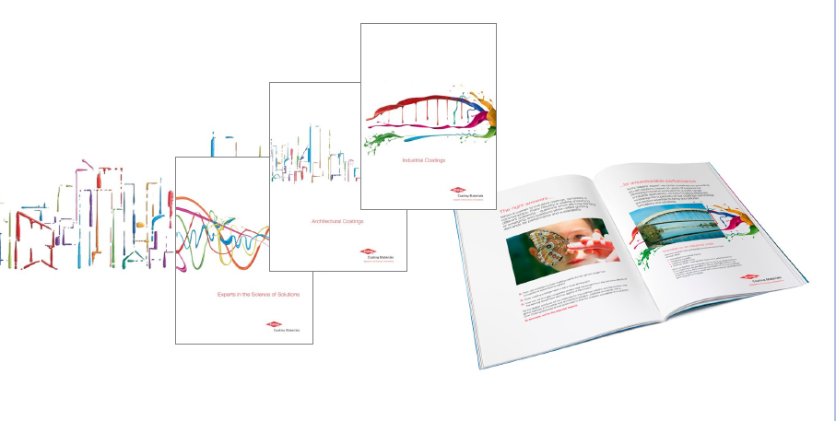
Brochures
Concept and copywriting for suite of brochures for Dow’s paint division

Slide 11

Exhibitions
Trade shows for Dow in Italy, Germany, Turkey, Saudi Arabia

Slide 12

Global events
For Syngenta in Brazil, China and Vietnam

Slide 13
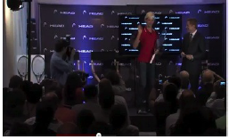
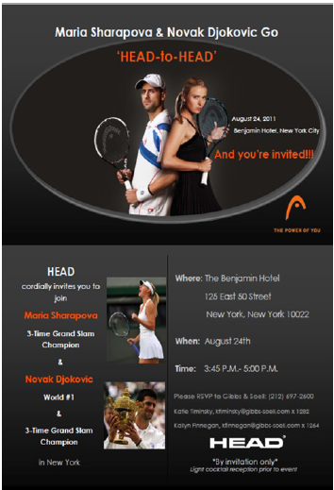
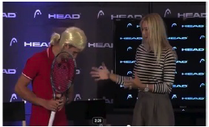
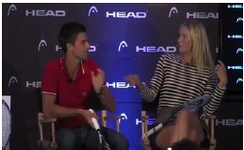
PR Campaigns: Head
Developed concept, copywriting & liaising with designers

Slide 14
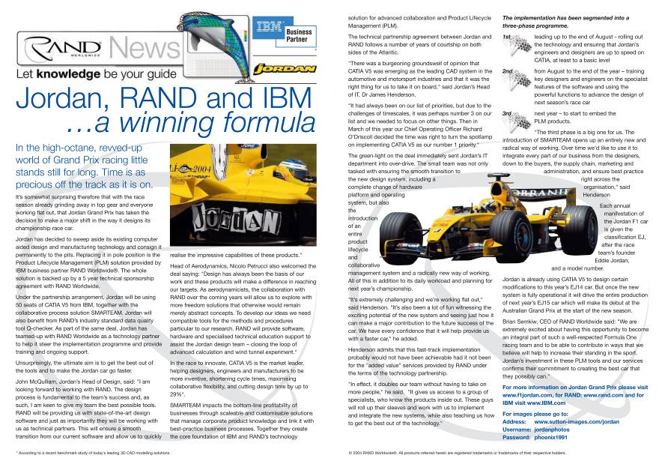
Writing: RAND and Jordan F1

Slide 15
Awards
WON
WON
WON
WON
Gold Winner Galaxy Awards 2011
for outstanding Achievement in Marketing
Nominated for a European Award for Excellence
PR Week
“Best in-house team”
BAIE*
Award for Excellence video news
Class Winner video news
Certificate of Merit corporate video
* BAIE – British Association of Industrial Editors

Slide 16
What I offer you
1
2
3
Strategic & tactical support. Broad skills base, extensive experience & a record of success
Hands-on attitude & ability to deliver projects un-supervised
Good writing, presentation, design and technology skills
contact: mobile + 41 79 504 69 41
email: horsleykevin0@gmail.com

